Slide 1

Data-Driven Insurance Premium Prediction
Amy Hatman
DSC680 – Applied Data Science
Notes:
Hello everyone. My name is Amy Hatman, and this is my presentation on Data-Driven Insurance Premium Prediction.

Slide 2
Introduction
Auto premiums were historically based on broad categories. With big data and machine learning, insurers can now tailor risk models more precisely.
Notes:
In this project, I applied data science techniques to explore how insurance companies can use predictive modeling to improve the way they set car insurance premiums. I’ll walk you through the business problem, the dataset, the methods I used, and what I found.
Insurance premium calculation has its roots in traditional actuarial science. Companies grouped drivers into broad categories, like age ranges or geographic regions, and charged premiums accordingly. This approach provided predictability but lacked precision. With advances in computing power and data availability, we now have the ability to analyze driver history, car details, and even real-time telematics data. My project takes a step toward this modern, data-driven approach to insurance pricing.
For this project, I worked with a dataset of 1,000 training records and 100 test records. Each record includes driver details like age, years of driving experience, accident history, and annual mileage, along with car age and the actual insurance premium. The dataset was clean, with no missing values, but I did notice redundancy—for example, both car age and car manufacturing year were included, which are perfectly correlated. I removed one of them to simplify the model. This ensures our models are not overcomplicated or distorted by duplicate information.

Slide 3
Business Problem
Insurance companies must balance fair pricing, profitability, and competitiveness. Traditional actuarial methods miss important nuances in driver risk.
Notes:
The core business challenge is balance. Insurers need premiums high enough to cover claims and remain profitable, but not so high that customers leave for competitors. Historically, companies relied on actuarial tables and demographic averages. While that works as a starting point, it ignores important differences in individual driver behavior and car use. With data science, we can build models that are both fairer and more accurate, reducing risk for companies and frustration for customers.

Slide 4
Methods
Performed exploratory data analysis, correlations, and tested models: Linear Regression, RidgeCV, Random Forest, and Gradient Boosting.
Notes:
My analysis followed a two-step process. First, exploratory data analysis—this included looking at distributions with histograms, identifying outliers with boxplots, and measuring relationships between variables with correlation matrices. Second, I built predictive models. I started with Linear Regression as a baseline, then tried Ridge Regression to reduce overfitting, and finally tested ensemble methods like Random Forest and Gradient Boosting, which tend to capture more complex patterns in the data.

Slide 5
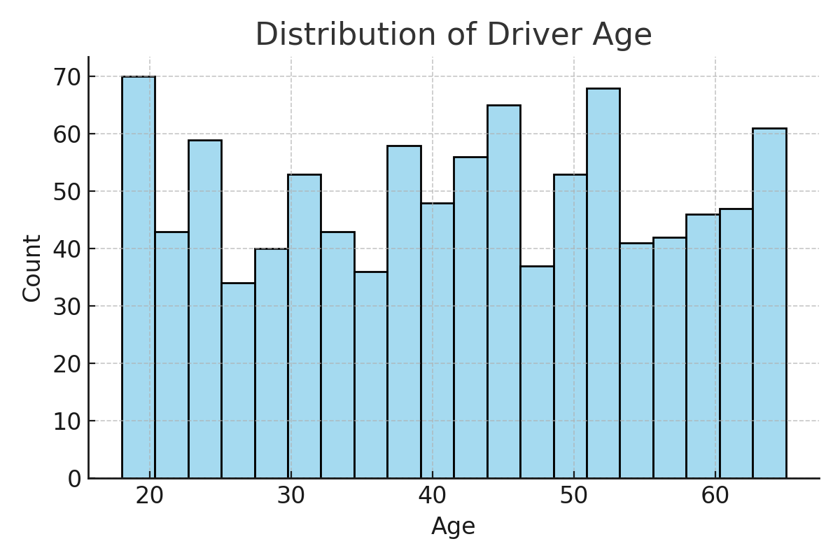
Analysis
Notes:
This histogram shows the age distribution of all drivers in the dataset. The x-axis represents driver age, and the y-axis represents the number of drivers in each age group. As you can see, the dataset includes drivers from roughly 18 to 65 years old, with a fairly even distribution across most age ranges. There are slightly higher counts among younger and middle-aged drivers, which makes sense since those groups tend to represent the bulk of insured customers. This wide age range gives the model a balanced perspective, helping it learn how age affects premium pricing. In general, younger drivers tend to pose higher risk and therefore pay higher premiums, while more experienced drivers typically benefit from lower rates.

Slide 6
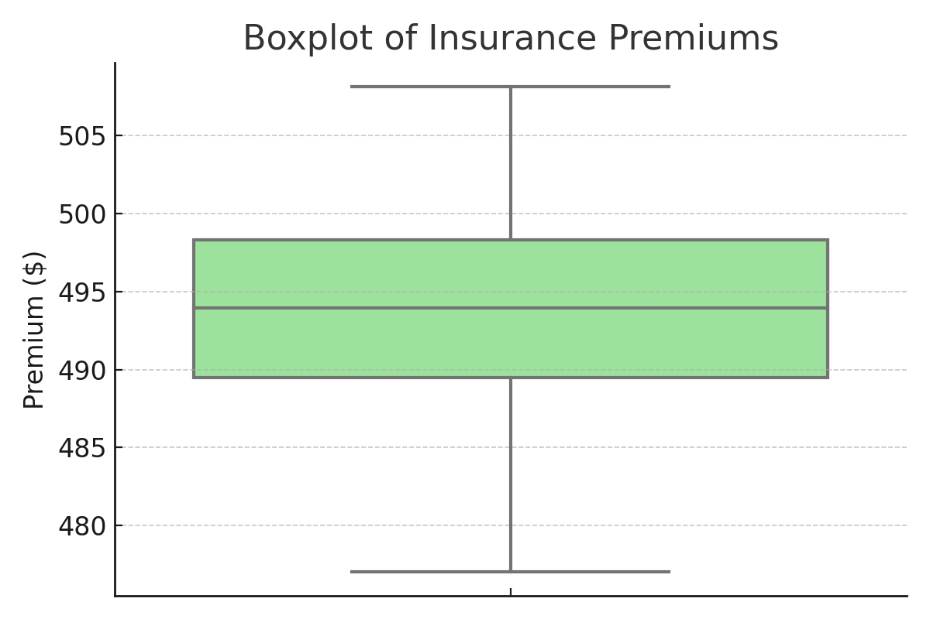
Analysis
Notes:
This chart shows the distribution of insurance premiums across all drivers in the dataset. The box represents the middle 50% of premiums, centered around roughly $490 to $495. The line inside the box marks the median premium — about $494. We can see that premiums are fairly consistent across most drivers, with only a few outliers at the lower and higher ends. This narrow range suggests that the dataset is relatively balanced, and that most customers are being charged within a similar price bracket.

Slide 7
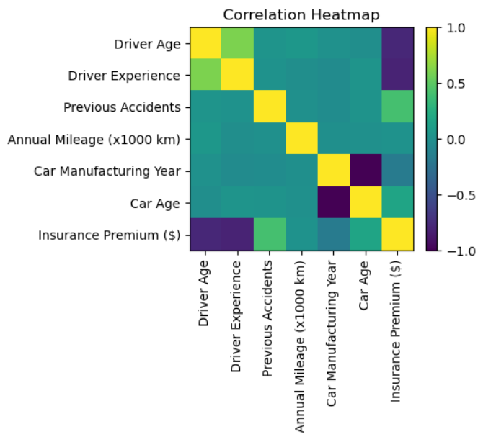
Analysis
Notes:
This heatmap shows the correlations between all the major features in the dataset. Correlation values range from -1 to 1, where -1 represents a strong negative relationship and 1 represents a strong positive relationship. Here we can see that driver age and driver experience are strongly correlated with each other, which makes sense—older drivers tend to have more years behind the wheel. Both age and experience have a strong negative correlation with insurance premiums, meaning as age or experience increases, premiums tend to decrease. We also see that the number of previous accidents is positively correlated with higher premiums, which is expected since drivers with more accidents are seen as higher risk. Car-related factors, such as car age or manufacturing year, show weaker relationships with premiums, indicating that driver behavior has a greater influence on cost than vehicle details. Overall, this heatmap gives us a clear picture of how each variable interacts and helps confirm that our dataset aligns with real-world insurance logic.

Slide 8
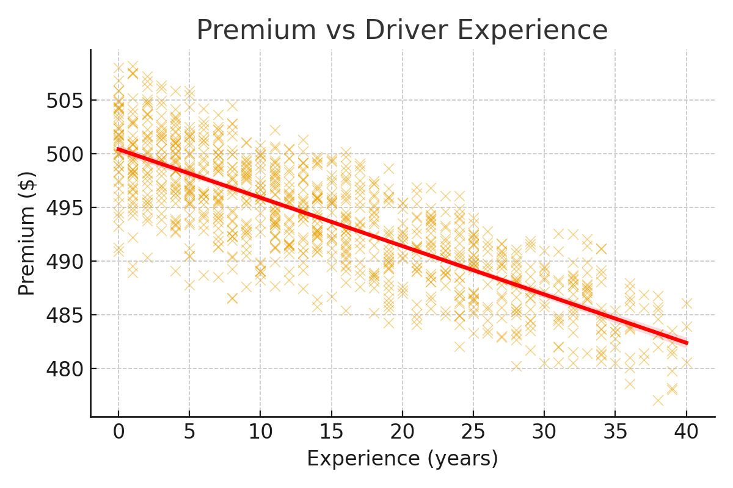
Analysis
Notes:
This scatterplot illustrates the relationship between driver experience, shown on the x-axis, and insurance premium, shown on the y-axis. Each point represents one driver from the dataset. Overall, we can see a slight downward trend, meaning that as driver experience increases, insurance premiums tend to decrease. The red regression line confirms this pattern. This makes sense—drivers with more years behind the wheel are generally less likely to be involved in accidents, and insurers reward that lower risk with reduced premiums. While the trend is clear, there’s still some variation at each experience level. That variation likely reflects other factors such as accident history or car age. The key takeaway is that driver experience is one of the most influential predictors of premium pricing in the dataset.

Slide 9
Implications
Predictive models must avoid bias, ensure fairness, and maintain transparency, especially when using factors like age or experience.
Notes:
One important dimension of predictive modeling is ethics. For example, age is one of the strongest predictors in this dataset. But is it fair to charge a driver more simply because of age? Using sensitive features like age can introduce bias or discrimination, even if the data shows strong correlation. Insurers need to balance predictive accuracy with fairness and transparency. Customers deserve to understand why their premium is what it is, and insurers need to ensure that models comply with ethical and regulatory standards.
Ethics is the backbone of predictive analytics. It’s not just about building accurate models—it’s about ensuring they’re fair, transparent, and responsible. Insurers should avoid variables that create unjust bias, like age, unless they are carefully managed. Customers deserve clear communication about why they’re paying what they’re paying. Following ethical best practices helps insurers build trust, prevent regulatory issues, and maintain a positive brand reputation.
One key limitation to the data set was dataset size. With only 1,000 training and 100 test records, the sample is too small to capture the full variability of insurance markets. Another limitation is scope—the dataset doesn’t include factors like location, car make and model, or telematics data. These missing variables are important in the real world. So, while the models performed well on this data, they wouldn’t be sufficient for production without more depth and scale.

Slide 10
Recommendations
Insurers should pilot predictive models on historical data, focus on driver-related factors, invest in telematics, and recalibrate models regularly.
Notes:
My recommendation to insurers is to start small—pilot these models with a subset of historical claims data. Evaluate performance, refine the model, and then expand. Focus first on driver-related factors, which proved most predictive. At the same time, begin investing in telematics and richer data sources to prepare for more advanced, real-time models. Regular model recalibration is also essential to maintain fairness and accuracy.

Slide 11
Roadmap
Start with historical validation, then pilot programs for small groups, expand rollout gradually, and monitor models continuously for fairness and accuracy.
Notes:
The implementation plan would start with historical data modeling, validating accuracy against actual claims. Next, insurers could launch a pilot program for select customer groups, comparing predictive pricing with traditional pricing. After that, expand gradually to larger customer groups. Finally, monitor results continuously, both for accuracy and fairness. Regular auditing ensures compliance and builds trust with customers.

Slide 12
Questions
Notes:
Why do driver details matter more than car details? Because the biggest risk factor in accidents is the human element—experience, age, and history—rather than the vehicle itself. Cars matter, but people matter more.
Why start with simple models first? Starting with linear regression gives a clear, interpretable baseline. Once we see how it performs, we can add complexity with models like Random Forest to see if they capture hidden patterns.
How well did the models predict premiums? The ensemble models, especially Gradient Boosting, performed best—lowering error rates compared to linear models. That shows the value of non-linear approaches when relationships are more complex.
What new data could improve predictions? Telematics data—things like how often a driver brakes hard, how late they drive, or how often they speed—would make models much stronger and more personalized.
Would the results hold on real-world data? Yes, but only if we scale up with larger and more representative datasets. With the right data, these results should generalize well.

Slide 13
Conclusion
Driver attributes dominate premium calculations. Findings confirm industry practices but also highlight opportunities for refined models.
Notes:
To sum up, the findings reinforce what insurers already know, but in a more precise and measurable way. Driver characteristics—especially age, experience, and accident history—dominate premium pricing. By applying machine learning, insurers can move beyond broad averages and design models that adjust dynamically as more data is collected. This provides an opportunity for pricing that is both fair and efficient.
In closing, this project highlights how data-driven methods can improve insurance pricing. By combining machine learning with ethical responsibility, insurers can set premiums that are accurate, transparent, and fair. Thank you for your time, and I’d be happy to answer any further questions.

Slide 14
References
Abbott, D. (2014). Applied predictive analytics: Principles and techniques for the professional data analyst. Wiley.
Deloitte. (2021). Insurance industry outlook: Balancing risk, regulation, and innovation. Deloitte Insights.
Insurance Information Institute. (2023). Auto insurance: Facts and statistics. Insurance Information Institute.
Sriram, G. (n.d.). Car insurance premium dataset. Kaggle.

